Slide 1
Sprawling Iranian Influence Operation Globalizes Tech’s War On Disinformation
Presented By: Matthew Stevenson
Original Authors: Craig Timberg, Elizabeth Dwoskin, Tony Romm, and Ellen Nakashima
Course: CS895
Date: 2019-03-20
Source: https://www.washingtonpost.com/technology/2018/08/21/russian-iran-created-facebook-pages-groups-accounts-mislead-users-around-world-company-says/

Slide 2
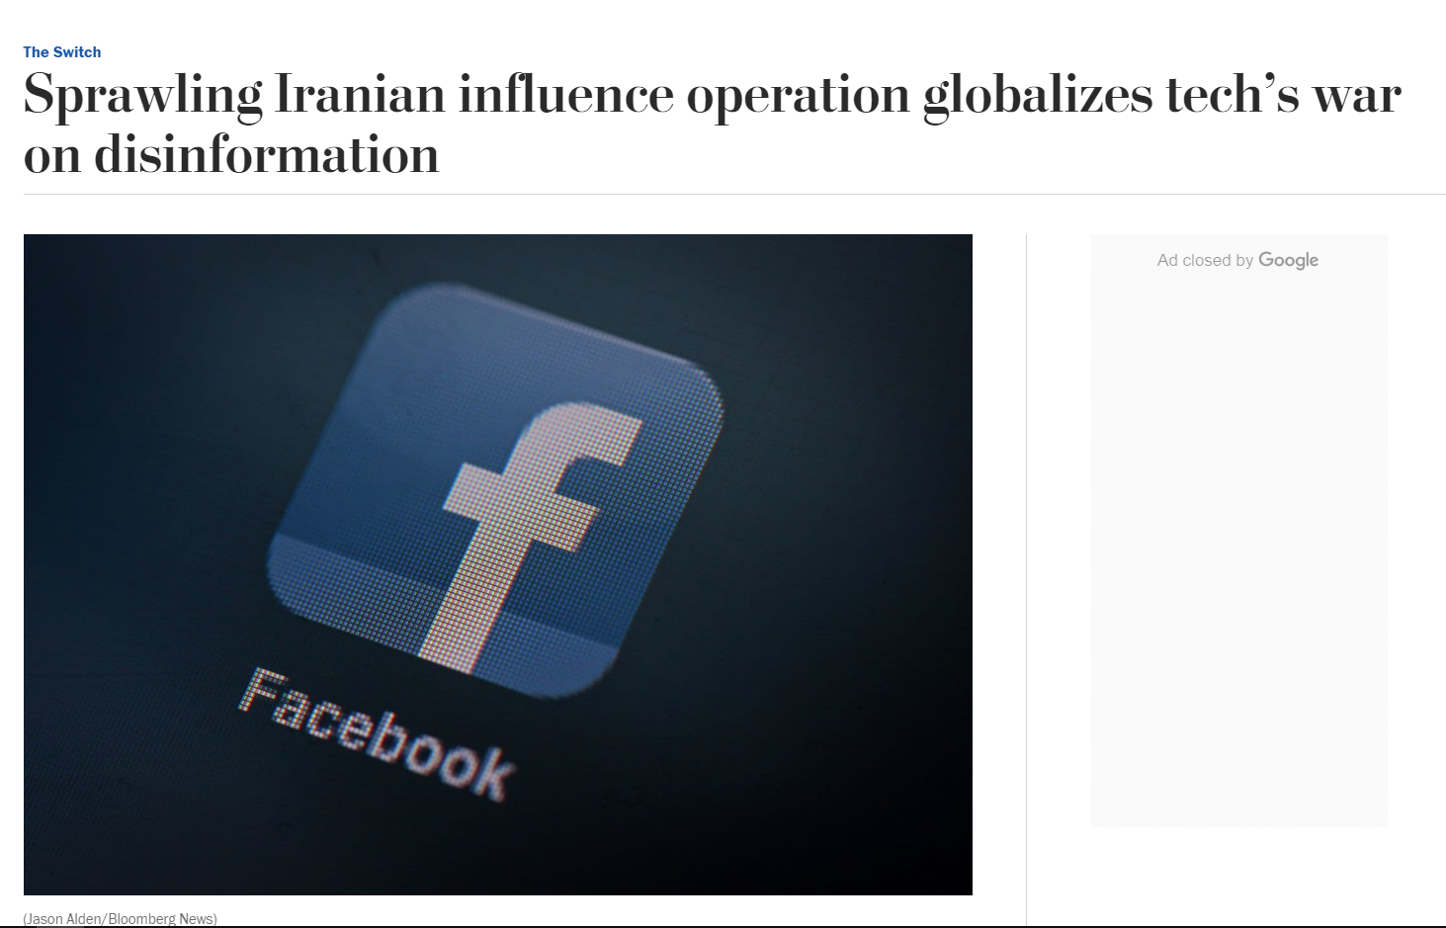
Globalizing False Information
Source: https://www.washingtonpost.com/technology/2018/08/21/russian-iran-created-facebook-pages-groups-accounts-mislead-users-around-world-company-says/

Slide 3
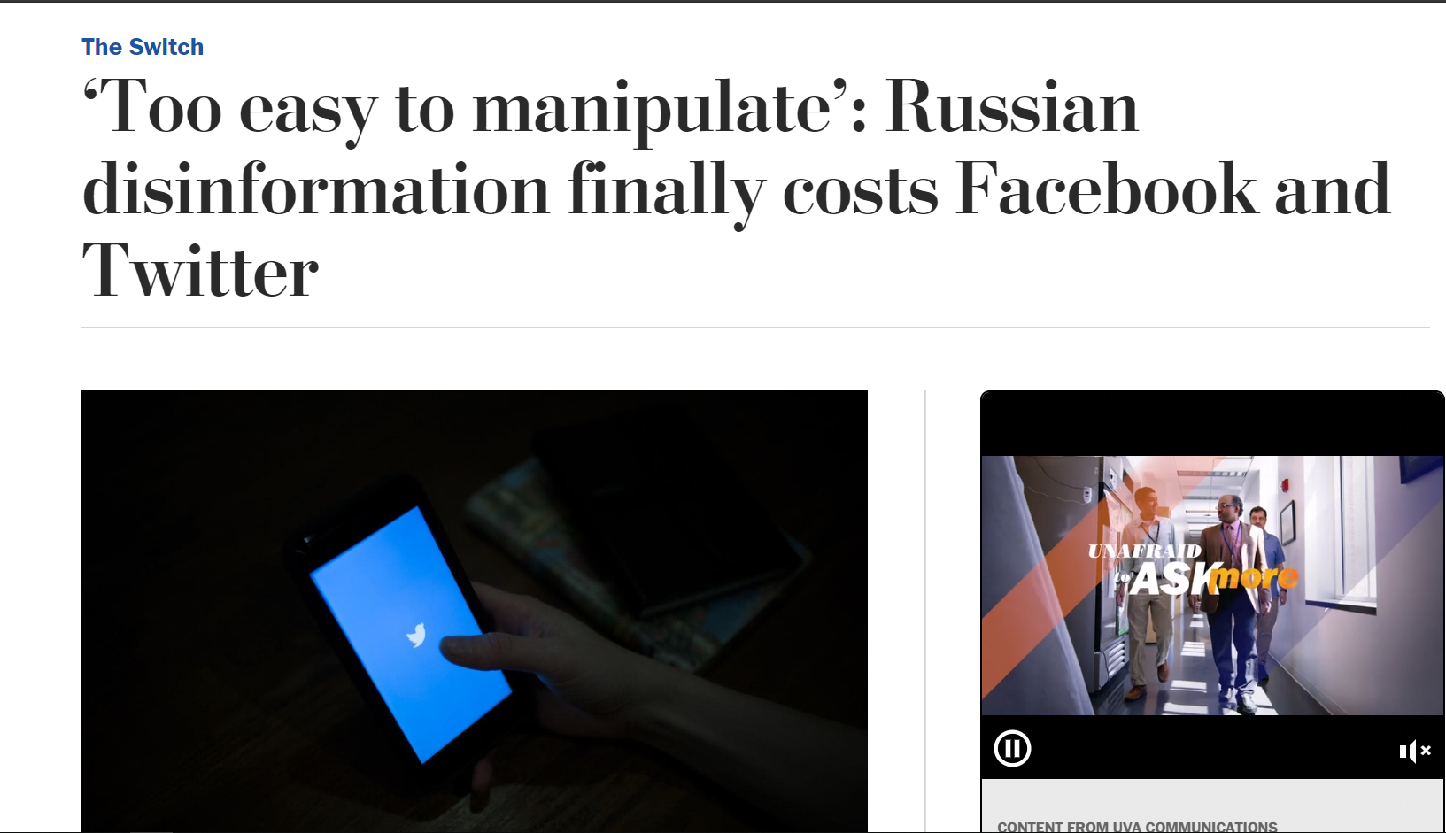
Russian Involvement Using Social Media
Source: https://www.washingtonpost.com/technology/2018/07/31/too-easy-manipulate-russian-disinformation-finally-costs-facebook-twitter/

Slide 4
The First Culprit: Internet Research Agency (IRA)
Group identity disclosed by Facebook
Influential campaign ordered by Vladimir Putin
Stationed in St. Petersburg
Facebook Influence:
3,393 advertisements
11.4 million American users exposed
470 IRA created Facebook pages
80,000 pieces of organic content on those pages
Organic content was exposed to 126 million Americans
Source: https://intelligence.house.gov/social-media-content/

Slide 5
Those Numbers Were Very Alarming
But What About Some Of The Advertisements?

Slide 6
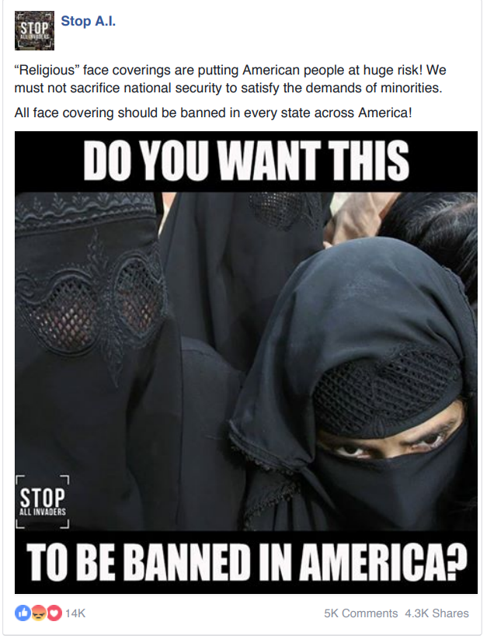
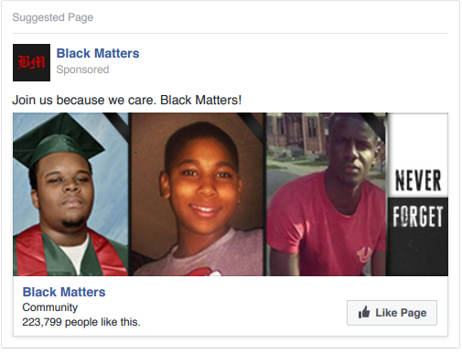
Controversial Facebook Ads
Source: https://intelligence.house.gov/uploadedfiles/fb_ad_black_matters.pdf
Source: https://intelligence.house.gov/uploadedfiles/1_of_3_stop_ai__1163765713737743.pdf

Slide 7
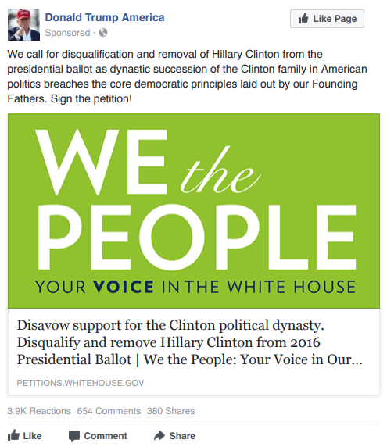
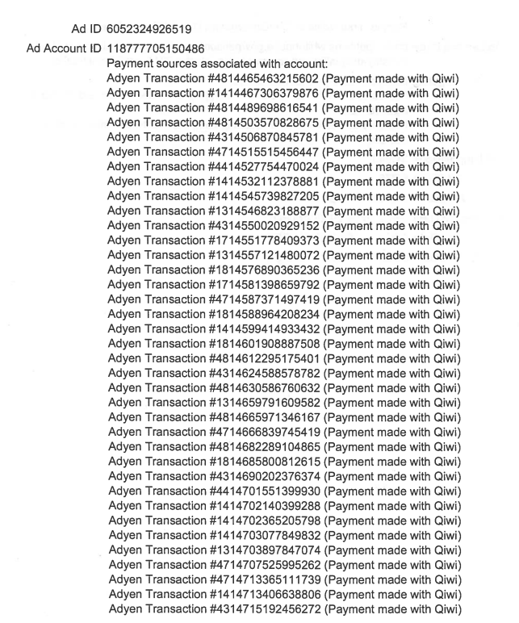
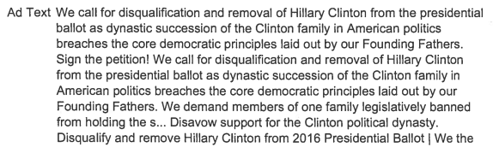
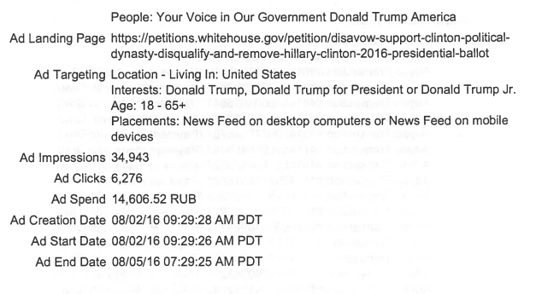
Facebook Ad And Metadata
14,606.52 RUB =~ 227.01 USD
Source: https://intelligence.house.gov/uploadedfiles/white_house_petition_metadata.pdf
Source: https://intelligence.house.gov/uploadedfiles/we_the_people_petition.pdf

Slide 8
But Is This Page Still Available?
Let’s Take A look At The Original Page

Slide 9
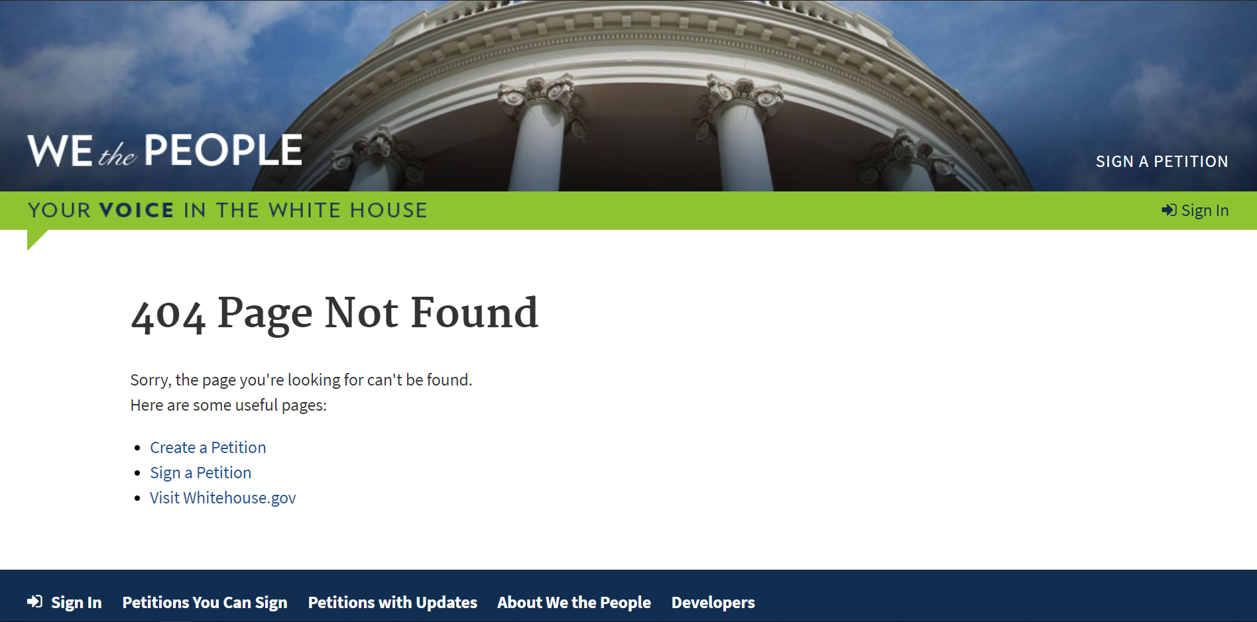
Page Unavailable
Source: https://petitions.whitehouse.gov/petition/disavow-support-clinton-political-dynasty-disqualify-and-remove-hillary-clinton-2016-presidential-ballot/

Slide 10
What Does The Internet Archive Show?
Let’s Find Out

Slide 11
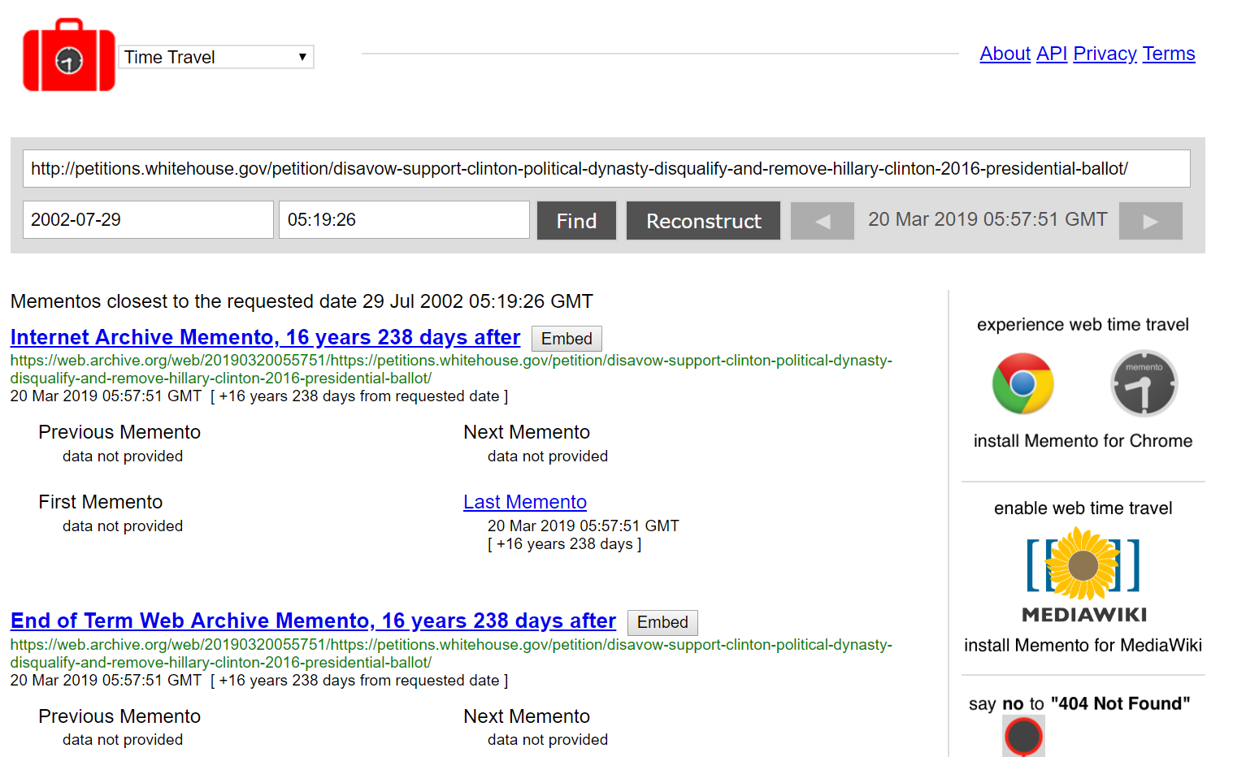
Mementos For Anti-Hillary Petition
Source: http://timetravel.mementoweb.org/list/20020729051926/https://petitions.whitehouse.gov/petition/disavow-support-clinton-political-dynasty-disqualify-and-remove-hillary-clinton-2016-presidential-ballot/

Slide 12
Maybe Twitter Can Give Us More Information
Let’s Look At Some Involved Twitter Handles

Slide 13
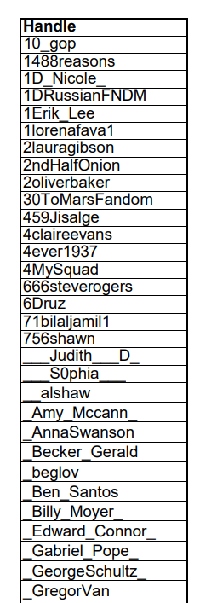
A Subset Of Associated Fake Twitter Accounts
Handles For Further Investigation:
@10_gop
@1488reasons
@1D_Nicole_
@1DRussianFNDM
@4MySquad
Source: https://intelligence.house.gov/uploadedfiles/ira_handles_june_2018.pdf

Slide 14
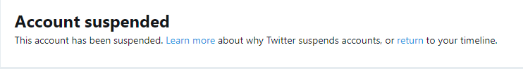
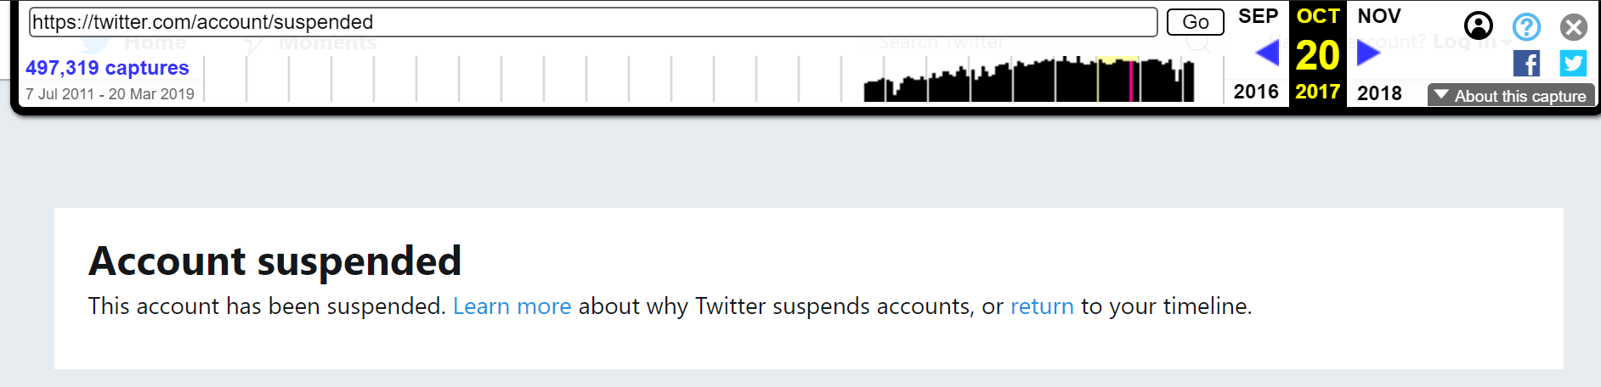
@10_gop
Source: https://twitter.com/10_gop
Source: https://web.archive.org/web/20171020161602/https://twitter.com/10_gop

Slide 15
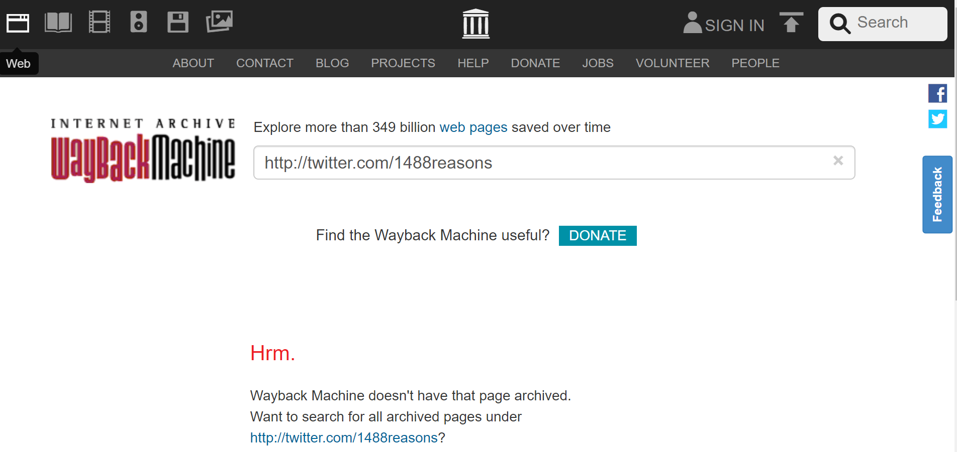
@1488reasons
Source: https://twitter.com/1488reasons
Not Archived
Source: https://web.archive.org/web/*/http://twitter.com/1488reasons

Slide 16
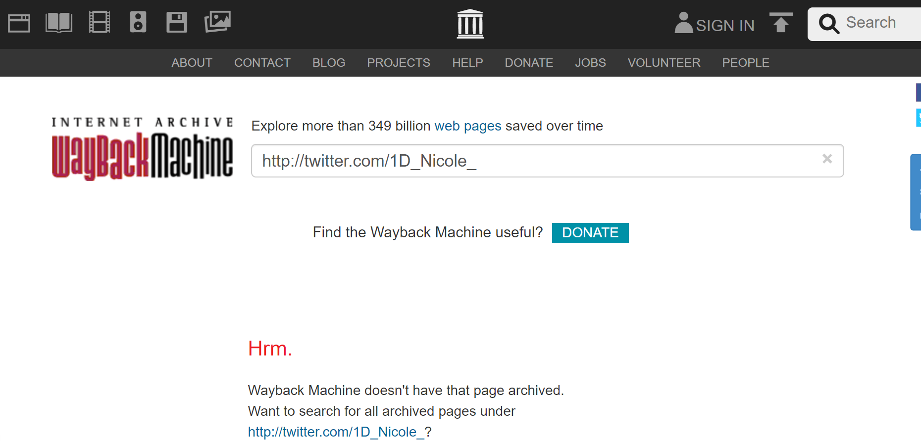
@1D_Nicole_
Source: https://twitter.com/1D_Nicole_
Not Archived
Source: https://web.archive.org/web/*/http://twitter.com/1D_Nicole_

Slide 17
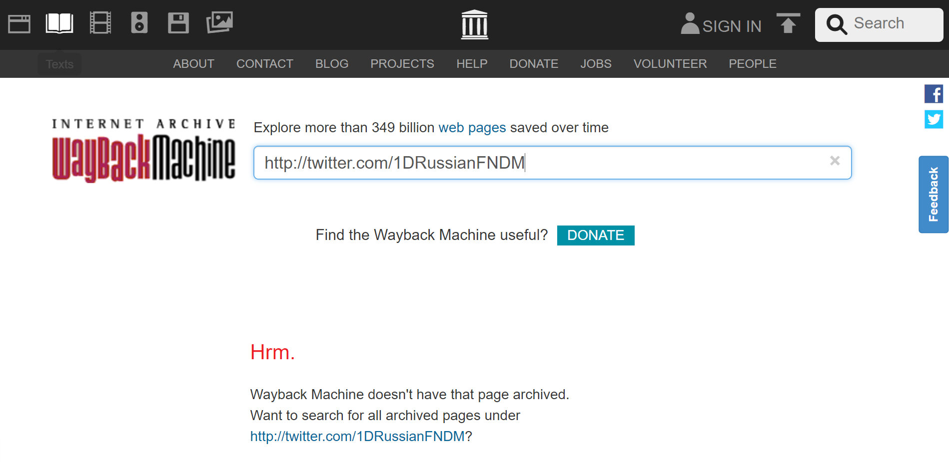
@ 1DRussianFNDM
Source: https://twitter.com/1DRussianFNDM
Not Archived
Source: https://web.archive.org/web/*/http://twitter.com/1DRussianFNDM

Slide 18
We Got Lucky With the Last Handle
The Account However Has Been Suspended From Twitter

Slide 19
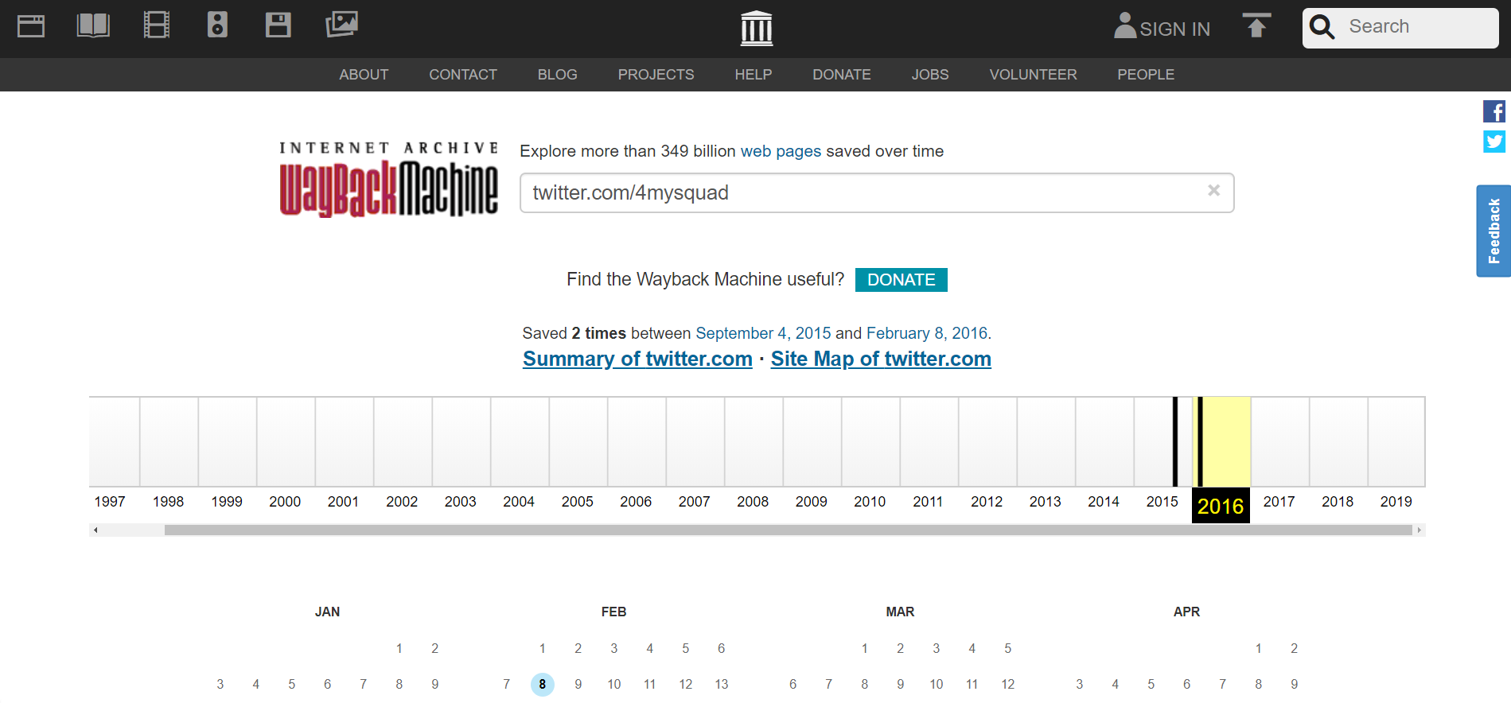
@4MySquad
Source: https://twitter.com/4MySquad
Source: https://web.archive.org/web/*/twitter.com/4MySquad

Slide 20
Two Entries Within The Archive
Let US Take A Look

Slide 21
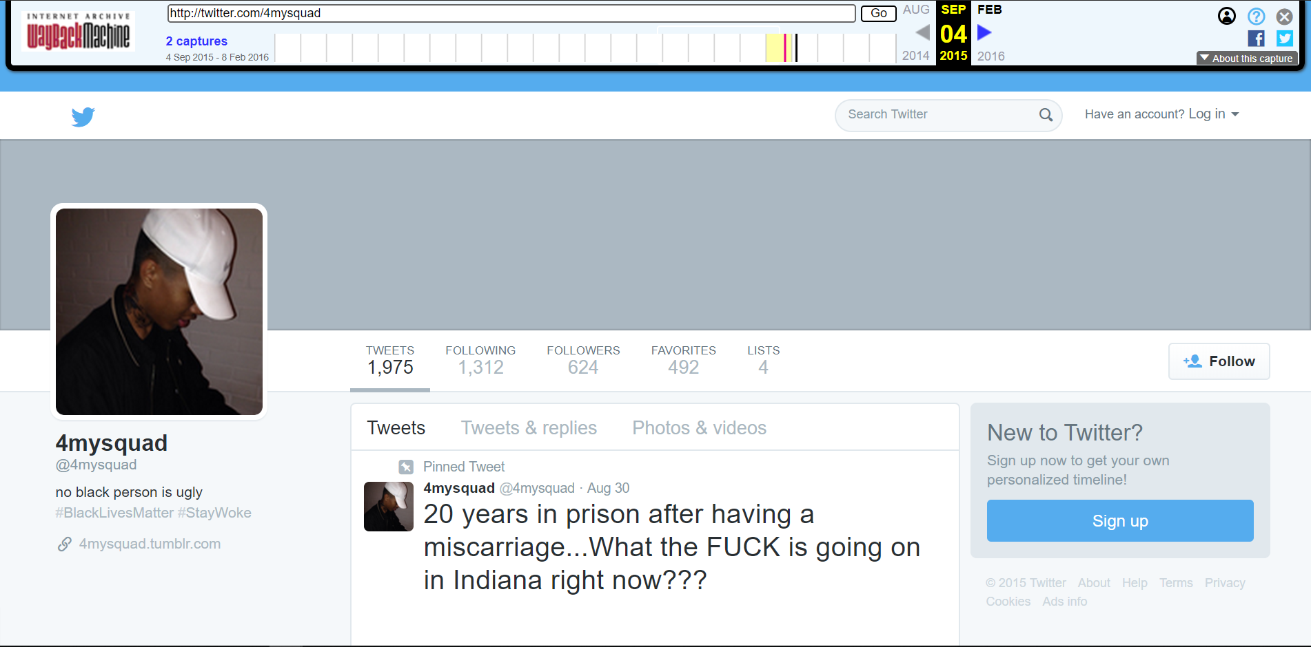
First Entry, 2015-09-04
Source: https://web.archive.org/web/20150904055426/twitter.com/4mysquad

Slide 22
Is This Account Part Of The IRA?
Let Us Review Some On This User’s Tweets

Slide 23
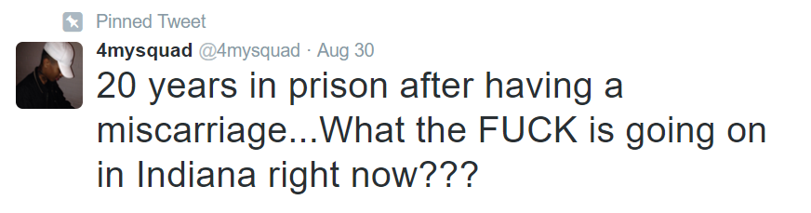
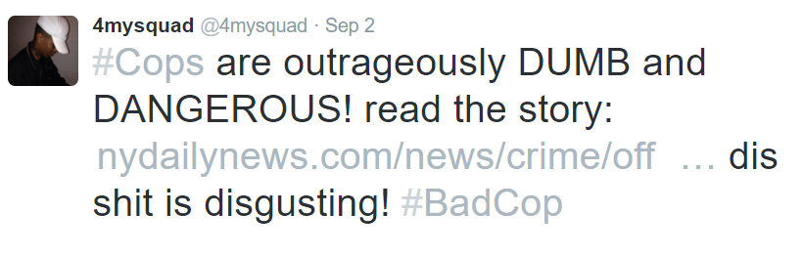
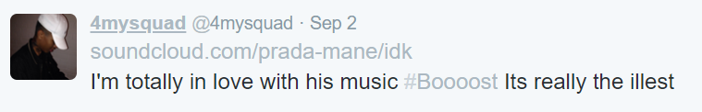
Most Recent Tweets From @4MySquad on 2019-09-05
Angry with a sentencing in Indiana based on a picture
Retweets an article of cops going to wrong house and people get shot
Retweets SoundCloud to a music link
Source: https://web.archive.org/web/20150904055426/twitter.com/4mysquad

Slide 24
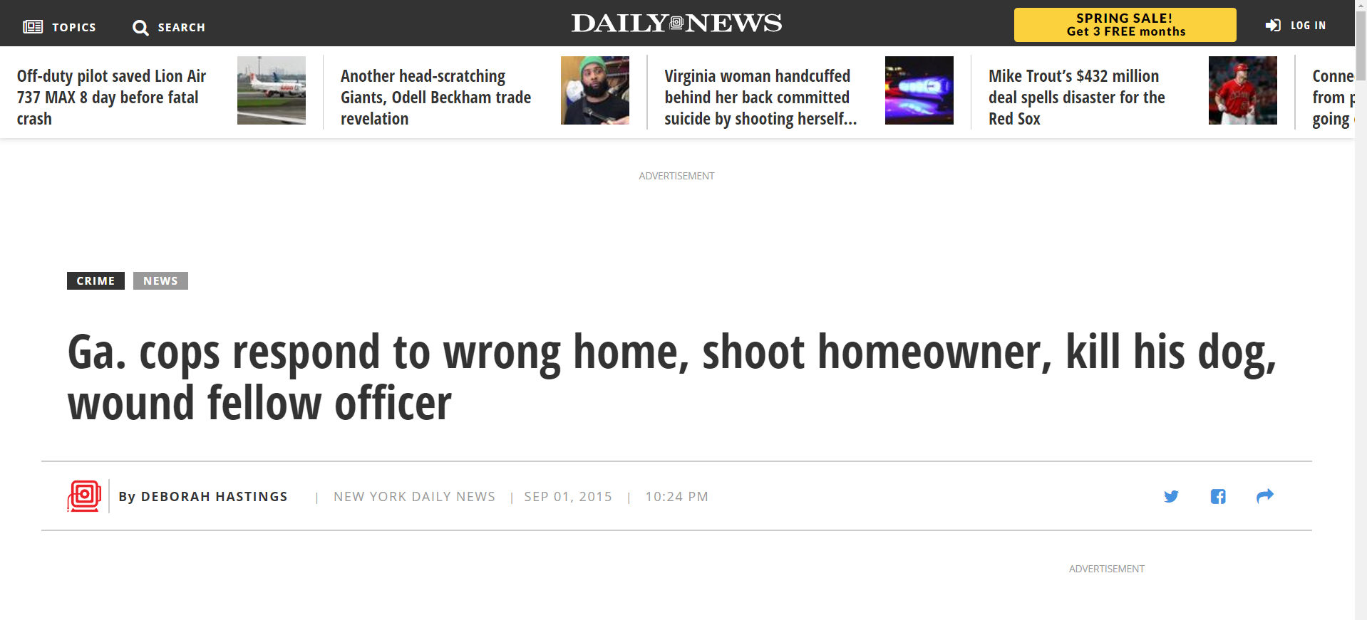
News Story From User’s Second Tweet Still Exists
Source: https://www.nydailynews.com/news/crime/officer-homeowner-shot-police-wrong-home-police-article-1.2343862

Slide 25
It Does Not Appear This Account Is Under Russian Control
But What About IN 2016?

Slide 26
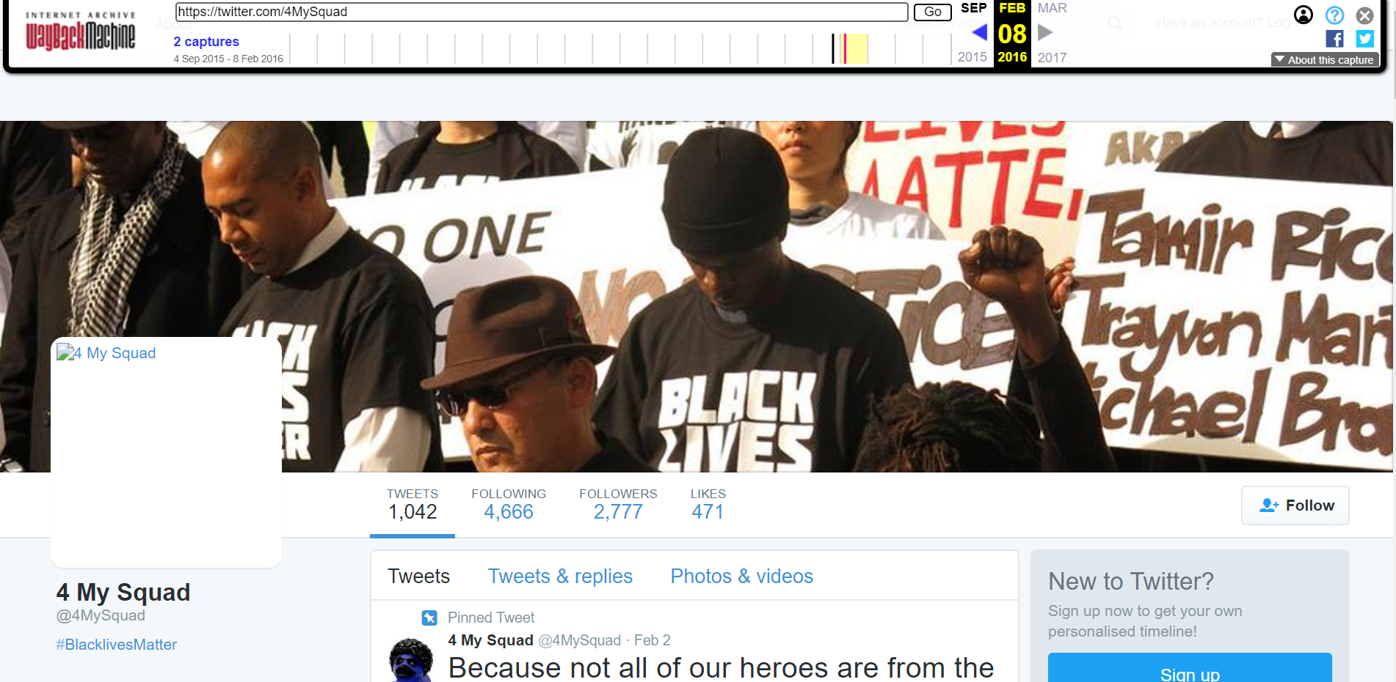
This User Page Already Has A Different Look And Feel, 2016-02-08
Source: https://web.archive.org/web/20160208193830/https://twitter.com/4MySquad

Slide 27
How Do These Accounts Compare To Each Other?
Let’s Look At Them Side By Side

Slide 28
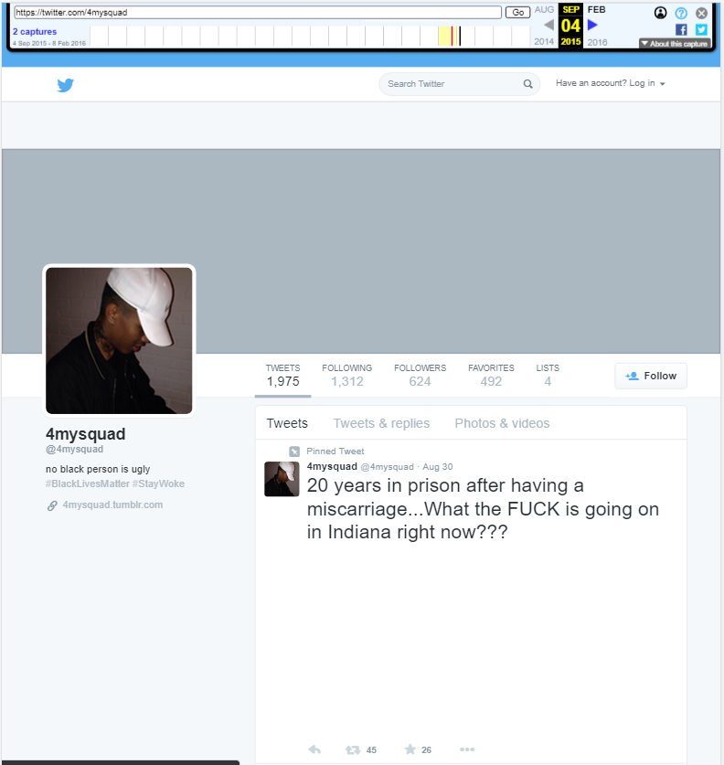
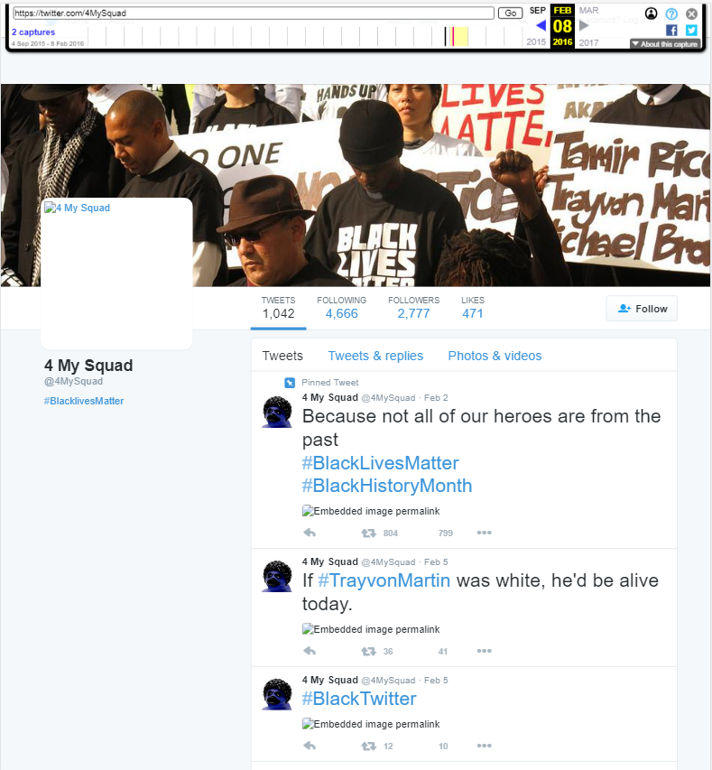
A lot Has Changed Between These Accounts
Source: https://web.archive.org/web/20150904055426/twitter.com/4mysquad
Source: https://web.archive.org/web/20160208193830/https://twitter.com/4MySquad

Slide 29
Based On The Differences In The Accounts Within The Timeline
Ownership Of The Account Has Changed and Is Likely Being Used To Spread Disinformation

Slide 30
Russia Is Old News
But What About The New Players Involved In Disinformation?

Slide 31
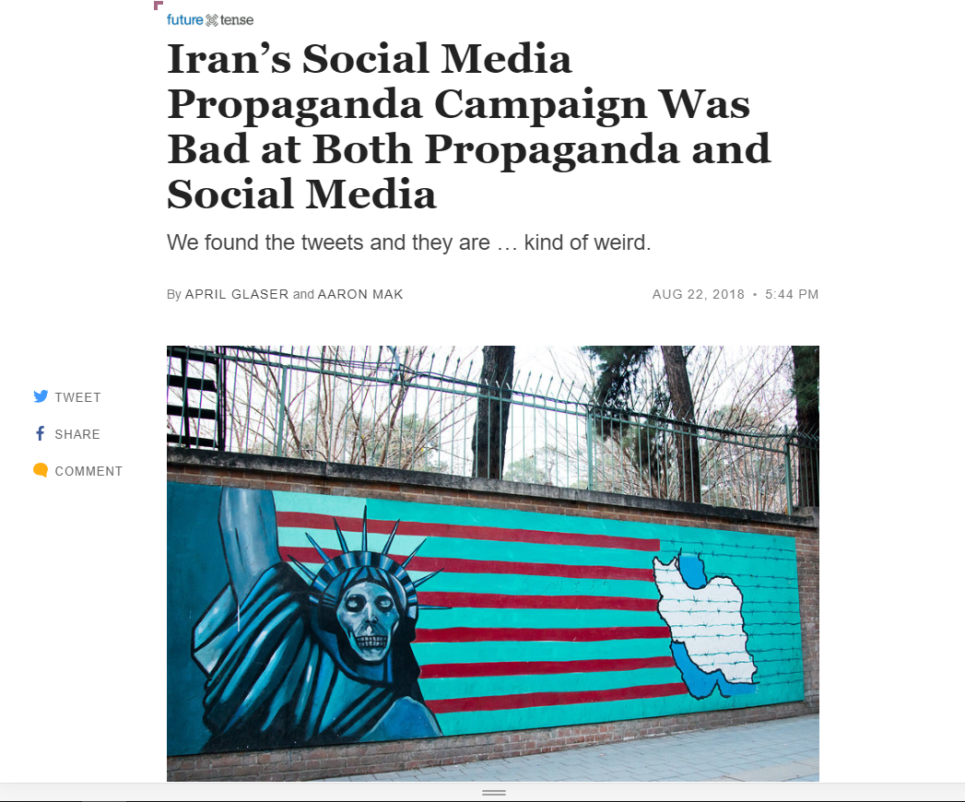
A New Media Campaign Arises
Source: https://slate.com/technology/2018/08/the-iranian-false-news-posts-on-facebook-and-twitter-were-not-very-convincing-or-good.html

Slide 32
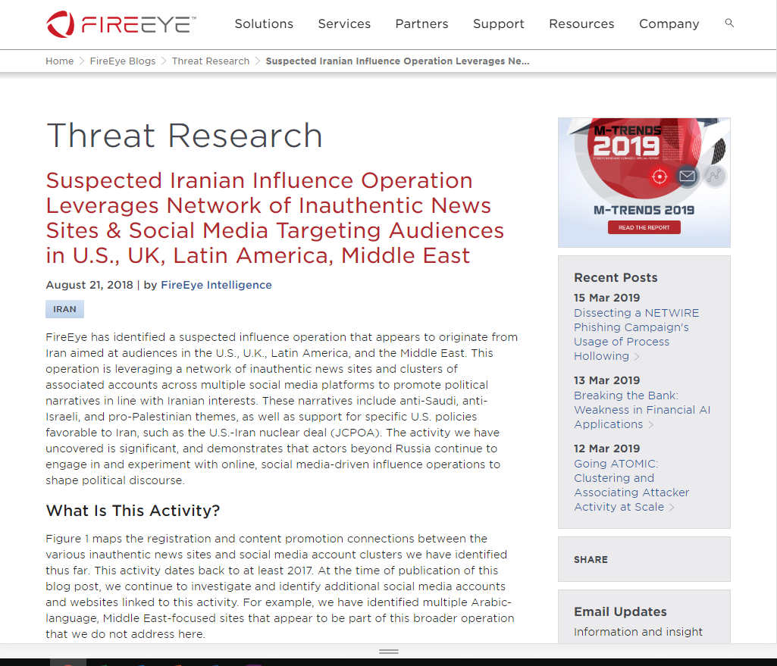
FireEye Gives A Tip Towards An Iranian Media Influence
Source: https://www.fireeye.com/blog/threat-research/2018/08/suspected-iranian-influence-operation.html

Slide 33
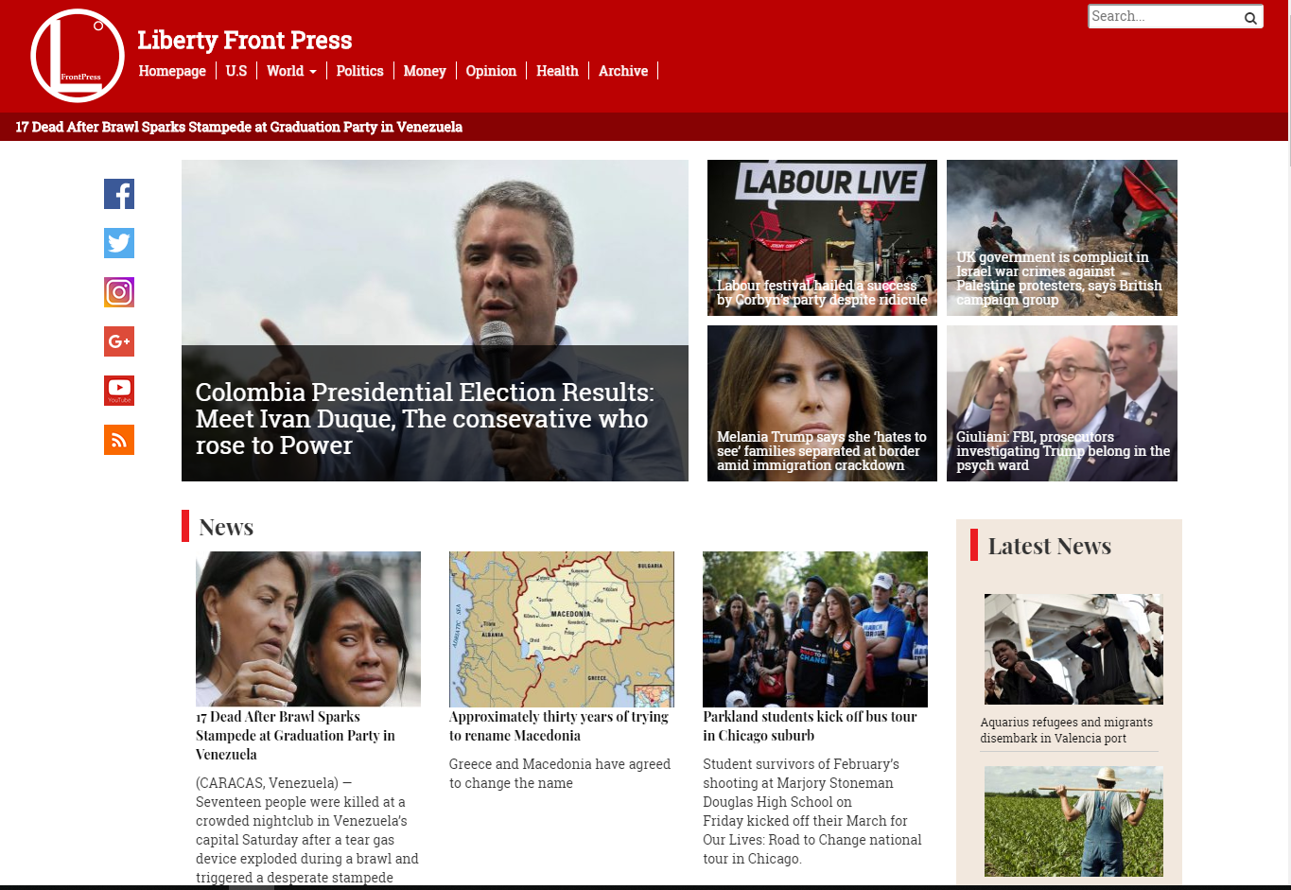
An Iranian News Site
Source: https://www.libertyfrontpress.com/

Slide 34
This News Site Has Social Media Links
Let’s Follow Them

Slide 35
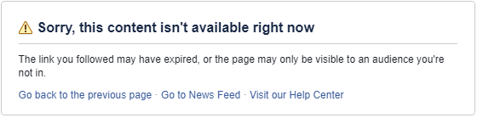
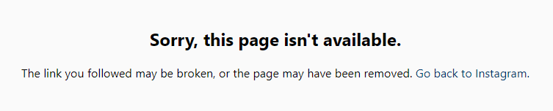
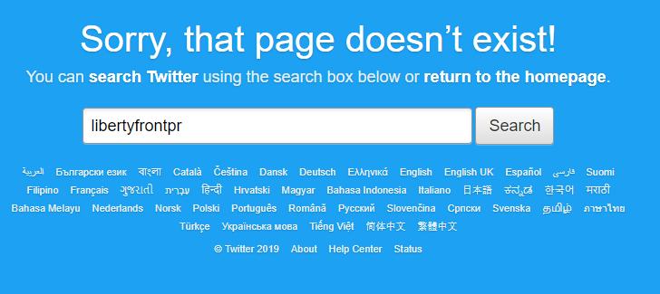
Social Media Results
Source: https://www.instagram.com/liberty_front_press/
Source: https://www.facebook.com/Libertyfrontpress-410534109315563/
Source: https://twitter.com/libertyfrontpr

Slide 36
It Is Quite Strange That A News Site Would Allow Broken Links On Their Main Page
Is There A Reason They Haven’t Been Corrected?

Slide 37
Maybe We Can Try Another Method With Twitter
Let’s Search For The News Site

Slide 38
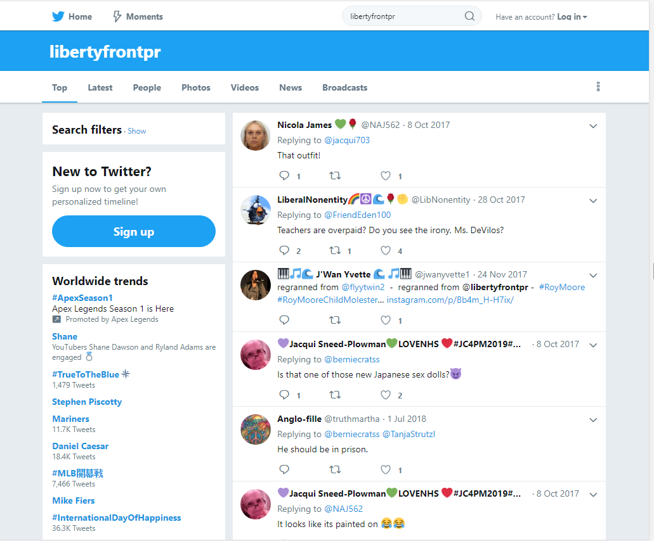
Twitter Search Results
Source: https://twitter.com/search?q=libertyfrontpr

Slide 39
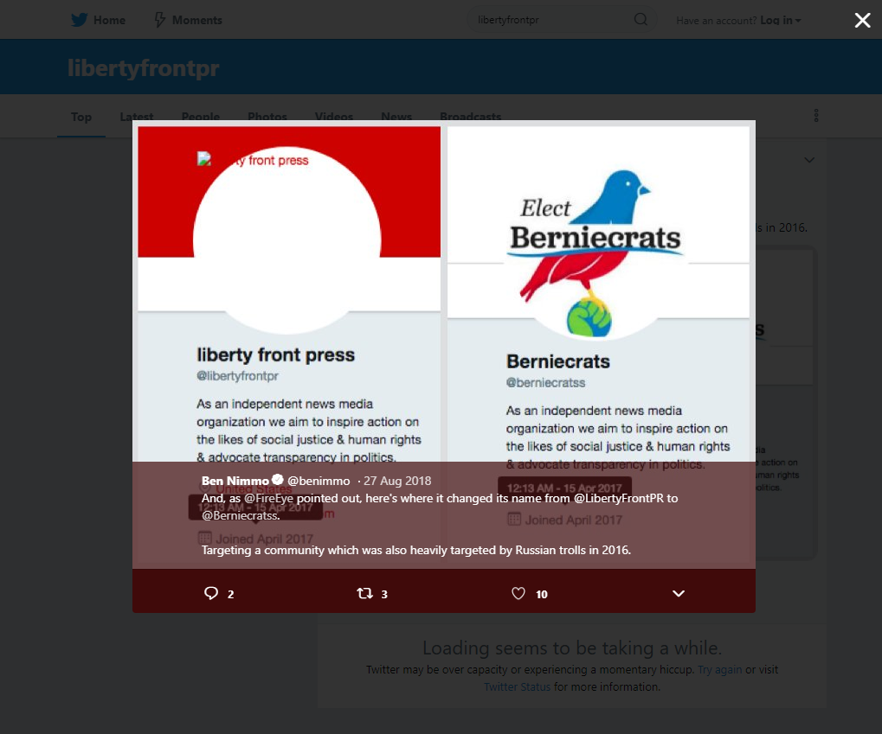
A New Identity Linked To LFP News Site?
Source: https://twitter.com/search?q=libertyfrontpr

Slide 40
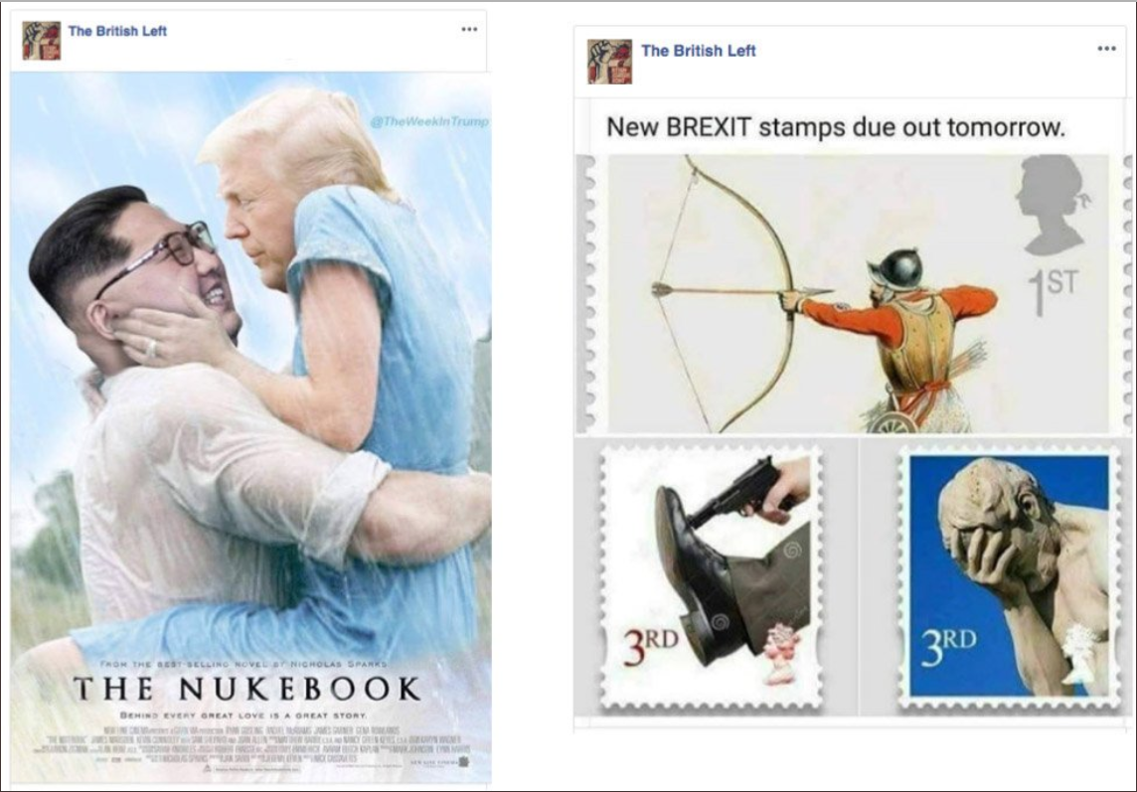
Photos Spreading Propaganda
Source: https://mobile.twitter.com/mathewjschwartz/status/1032217384776593408/photo/1

Slide 41
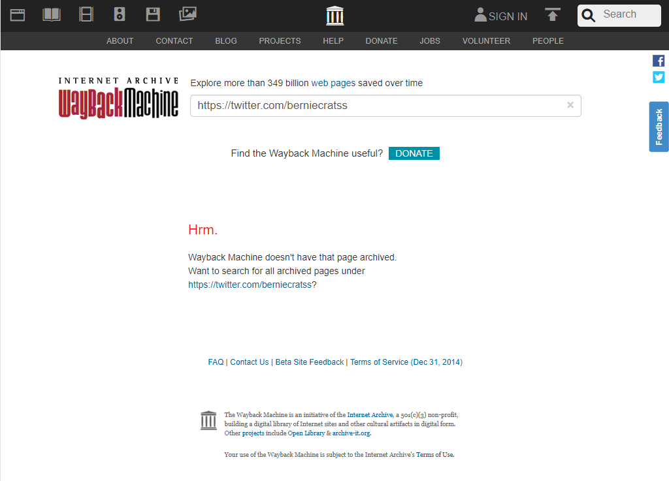
Current State Of @berniecratss Account
Source: https://twitter.com/berniecratss
Source: https://web.archive.org/web/*/https://twitter.com/berniecratss

Slide 42
Global Efforts Towards Misinformation
Russia is not alone in creating misinformation
There is not enough evidence available to determine the vastness or complexity of Liberty Front Press
Known social media accounts of Liberty Front Press are not available and non existent within the archive
Liberty Front Press is sloppy at covering tracks to further extort their operation

Slide 43
Contact Information:
Github: https://github.com/mst3v3nsn
Google Groups: https://groups.google.com/forum/#!forum/cs895-s19

